Slide 1


MPPHSCL Parakh
Web & Mobile Version
वेब & मोबाइल एप्लीकेशन — User Manual
Health Department — Hospital Inspection Web Version
User Creation, Forms Access & Login Guide
Madhya Pradesh Public Health Services Corporation Ltd. (MPPHSCL)
MPSEDC | State IT Center, 47-A, Arera Hills, Bhopal, M.P. – 462011 | www.mpsedc.mp.gov.in

Slide 2
📋 Agenda
01
Overview — What is Parakh?
04
Web Login Process
Digital solution by MPSEDC
Step-by-step login guide
02
Application Forms
05
New User Registration
4 types of inspection forms
Collectorate → CMHO → Field Engineer
03
User Types & Hierarchy
06
Mobile App — District GIS Parakh
Department, Agency & Citizen Users
Login & form filling on mobile

Slide 3
01 | Overview — What is Parakh?
3 User Types
परख — Parakh
Department Users
A comprehensive digital solution developed by Madhya Pradesh State Electronics Development Corporation (MPSEDC) for inspection and data collection across health facilities.
विभागीय उपयोगकर्ता
Agency Users
Supported Platforms:
एजेंसी उपयोगकर्ता
🌐 Web Application
https://gisuat.mp.gov.in/parakhweb/
📱 Mobile Application
District GIS Parakh (Android App)
Citizen Users
नागरिक उपयोगकर्ता
MPPHSCL Focus: Health Dept.

Slide 4
02 | Application Forms for MPPHSCL Health Department
Input Form Types
Hospital Facility Types Covered
📋 सामान्य विभाग फॉर्म
1
District / Civil / Super Speciality Hospital
Department General Form
जिला / सिविल / सुपर स्पेशियलिटी अस्पताल
📄 सामान्य फॉर्म
2
Community Health Centre (CHC)
General Form
सामुदायिक स्वास्थ्य केंद्र (सीएचसी)
🗂️ डेटा संग्रह
3
Sub Health Centre (SHC)
Data Collection Form
उप स्वास्थ्य केंद्र (एसएचसी)
🔍 निरीक्षण फॉर्म
4
Primary Health Centre (PHC)
Inspection Form
प्राथमिक स्वास्थ्य केंद्र (पीएचसी)

Slide 5
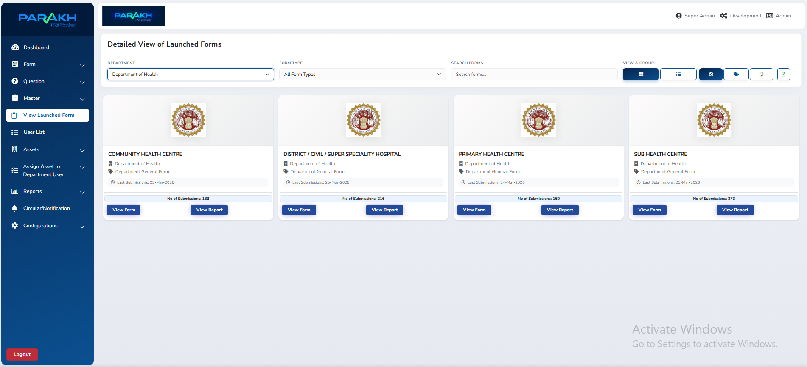
02 | Application Forms for MPPHSCL Health Department
Hospital Facility Types Covered
1
3
4

Slide 6
03 | Department Hierarchy & User Workflow
ADMIN
Admin Provides Credentials
System Administrator
Collectorate login credentials are provided by the Admin.
COLLECTORATE
Collectorate Creates Users
Level 1 — 55 Districts
dm_districtname
Can create CMHO (Level 2) and Field Inspectors/Surveyors.
CMHO
CMHO Creates Users
Level 2 — Chief Medical Health Officers
cmho_hospitalname
Can also create Field Inspectors/Surveyors independently.
FIELD ENGINEER / SURVEYOR
Field Engineer Submits Forms
Fills Hospital Inspection Forms during physical visits.
Fills Inspection Forms

Slide 7
04 | Web Application Login Process
Step 1
🌐 Open Web Browser
Step 2
📍 Allow Location Permission
Search for "Parakh" application or directly open:
https://gisuat.mp.gov.in/parakhweb/
A location access prompt may appear on first launch.
Click "Allow" or "अनुमति दें" to grant location access.
Step 3
🔑 Enter Credentials
Step 4
🏥 Access Dashboard
Enter your Username and Password as provided by Admin.
Click the Login button to access the dashboard.
After login, navigate to the MPPHSCL inspection forms
for Health Department hospital assessments.

Slide 8
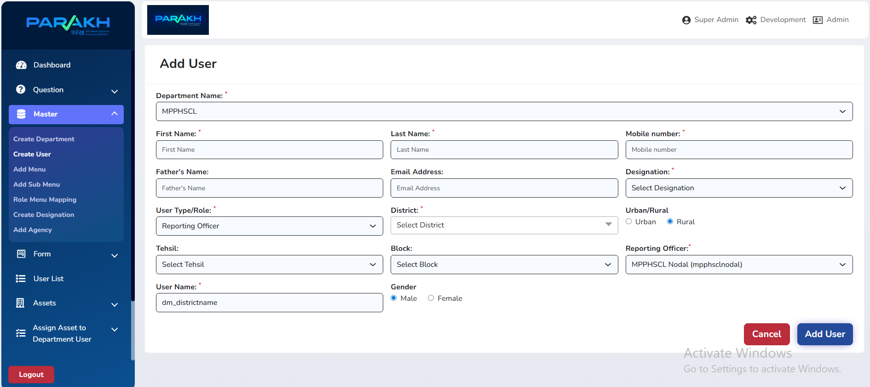
05 | New User Registration
Step 1 of 3
Reporting Officers Level 1 — Collectorate Creation
🏛️
Create Reporting Officers at Level 1 under Collectorate login
One for each of the 55 Districts of Madhya Pradesh
✏️
Follow the Naming Convention: "dm_districtname"
e.g., dm_bhopal, dm_indore, dm_jabalpur
🔐
Collectorate Login Credentials provided by the Admin
Admin manages the top-level access provisioning
👷
Collectorate login can create Field Inspectors / Surveyors
Grants downward delegation of user creation

Slide 9
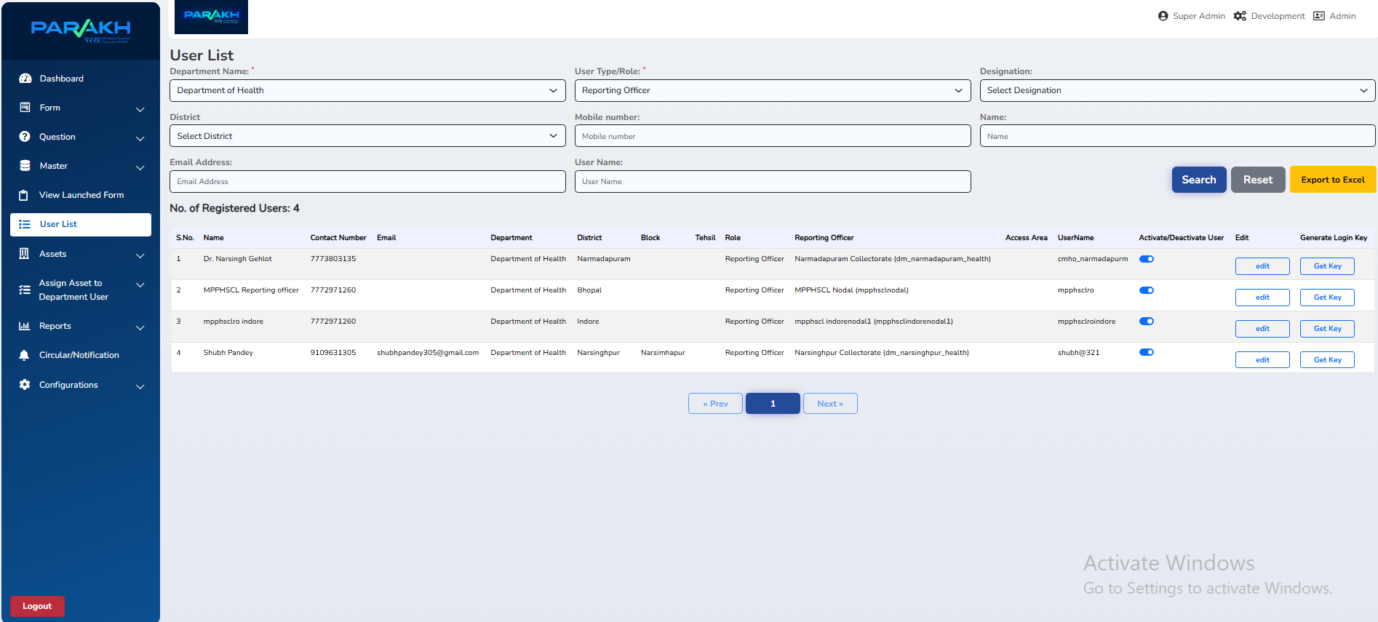
05 | New User Registration
Step 2 of 3
Reporting Officers Level 2 — CMHO Creation
🏥
Create Chief Medical Health Officers (CMHO) at Level 2
These are hospital-level reporting officers
✏️
Naming Convention: "cmho_hospitalname"
e.g., cmho_aiims_bhopal, cmho_chc_berasia
👷
CMHO login can also create Field Inspectors / Surveyors
Works independently or under Collectorate supervision
💡 Note: CMHO officers can independently create surveyors for their respective hospitals without needing Collectorate login.

Slide 10
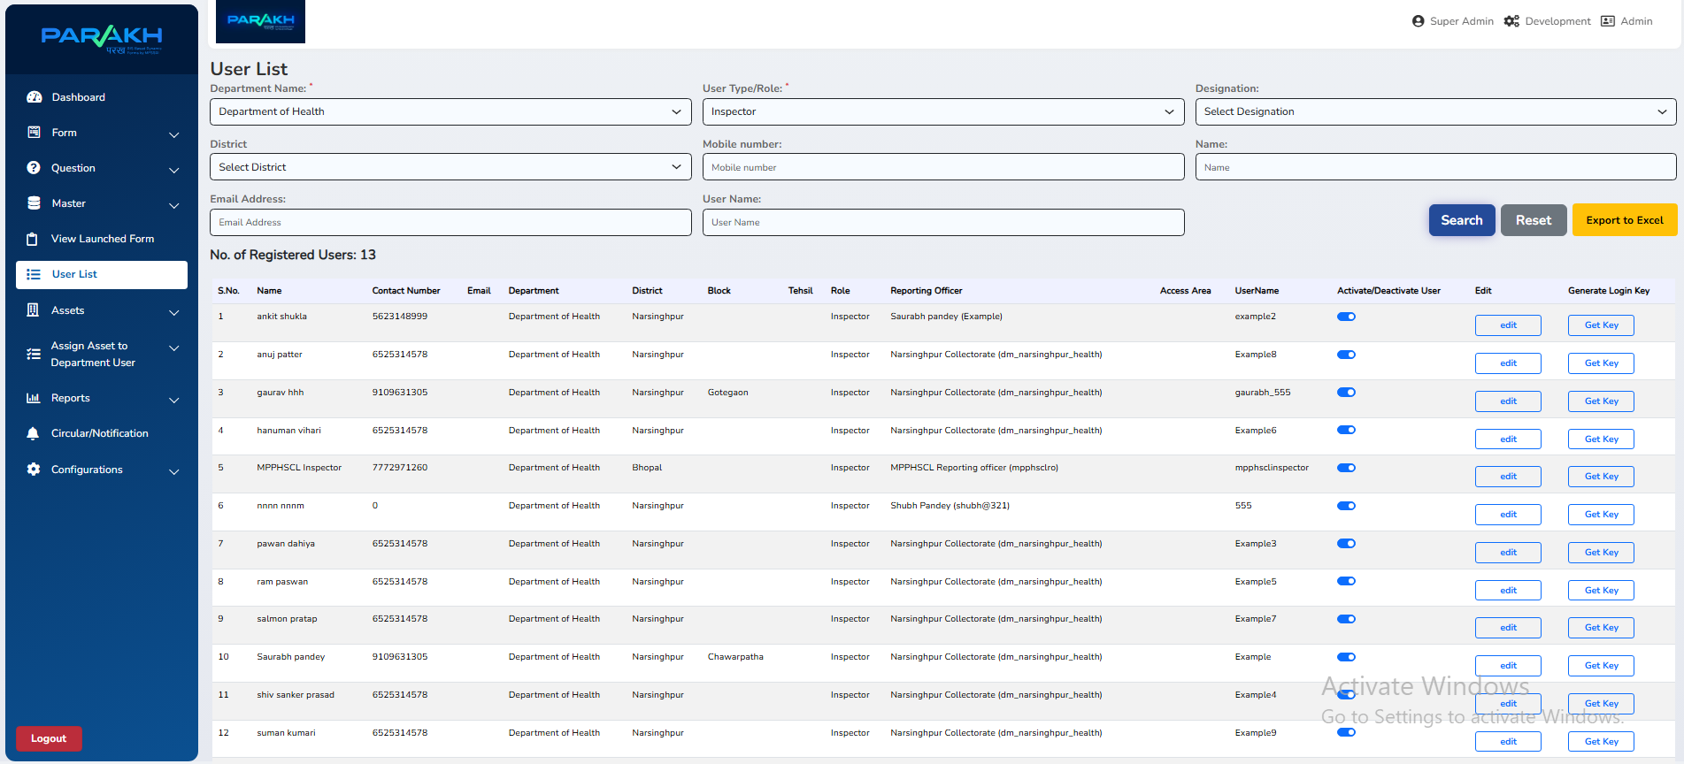
05 | New User Registration
Step 3 of 3
Field Engineer / Surveyor Creation
👷
Create Field Engineers / Surveyors under Collectorate or CMHO
Both Level 1 and Level 2 officers can create these users
📌
Can report to Collectorate of District OR CMHO of Hospital
Flexible reporting structure depending on jurisdiction
📋
Field Engineer / Surveyor fills Inspection Forms
Covers all 4 facility types: District, CHC, SHC, and PHC
✅ Once created, the Field Engineer can immediately log in to the mobile app and begin submitting inspection reports.

Slide 11
06 | Mobile App — District GIS Parakh
📱 Mobile Login Steps
🏠 MPPHSCL Dashboard Cards
1
Open "District GIS Parakh" App
📝
💾
Search & install from Play Store
New Forms
Draft Saved
2
Search for "Bhopal District"
or your respective district
✅
👤
3
Tap "Select Department" Button
Submitted Forms
Profile
Choose MPPHSCL / Health Dept
📶
4
Enter Username & Password
Credentials given by Collectorate/CMHO
Offline Forms
5
Press Login Button
💡 Select "New Form" to begin
a hospital inspection during a physical visit.
MPPHSCL Dashboard opens

Slide 12
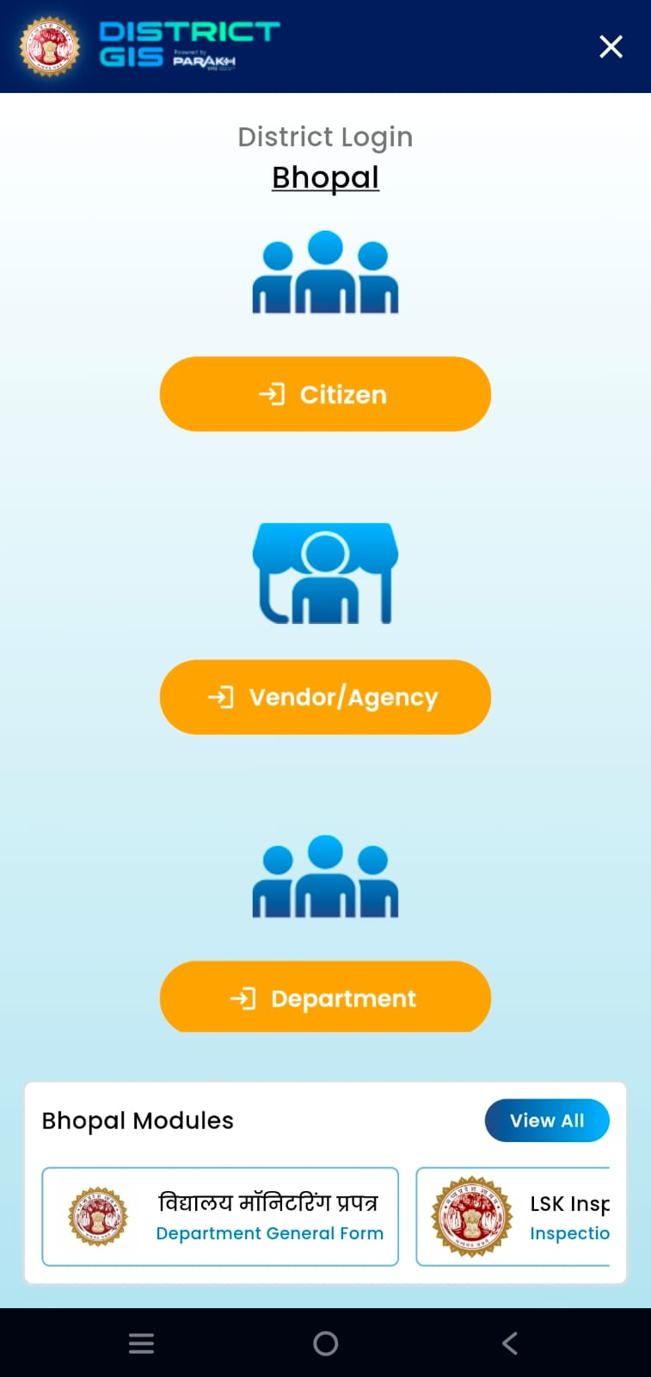
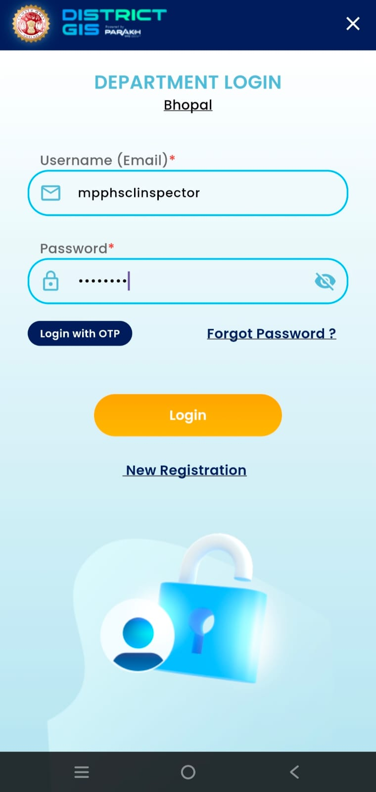
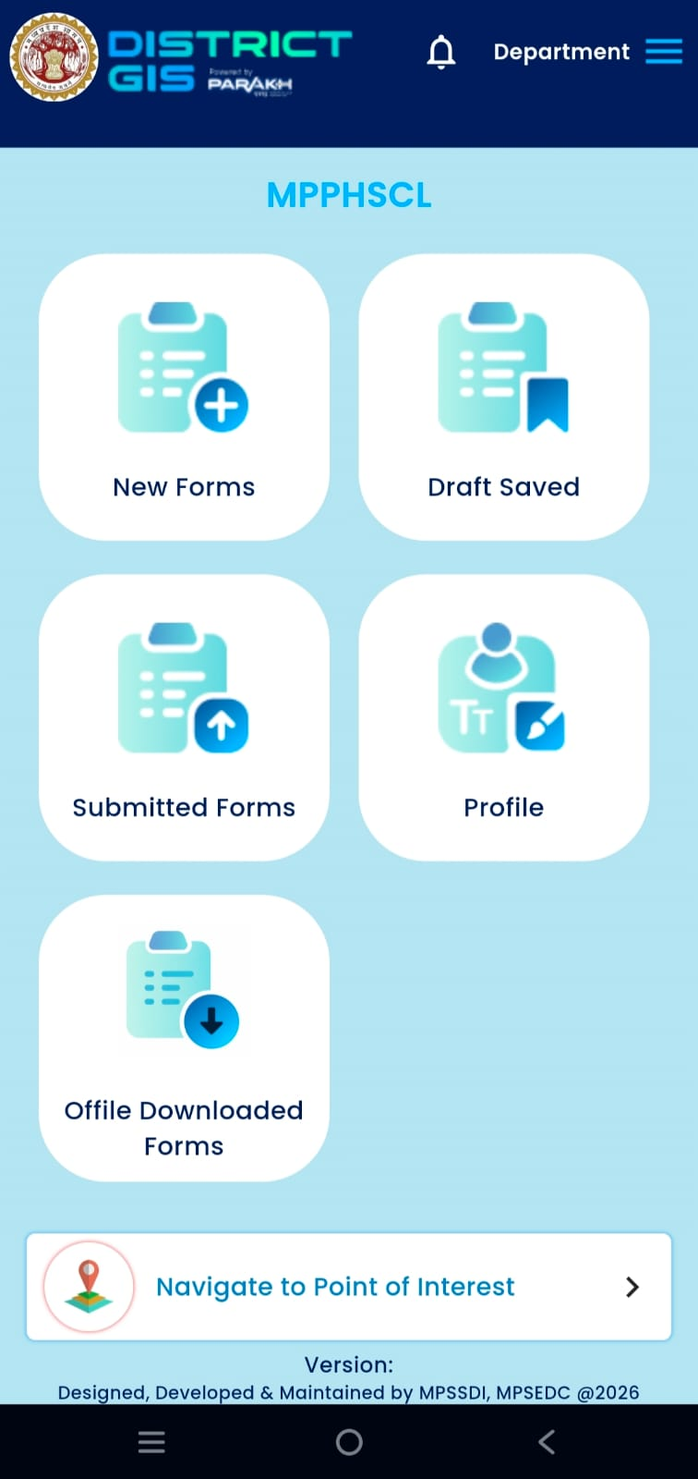
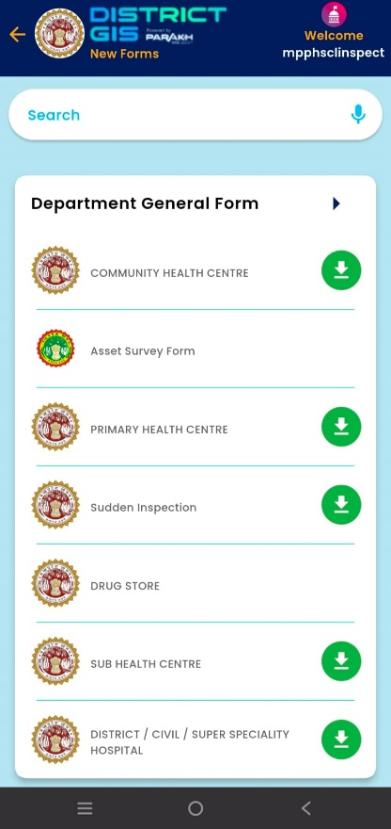
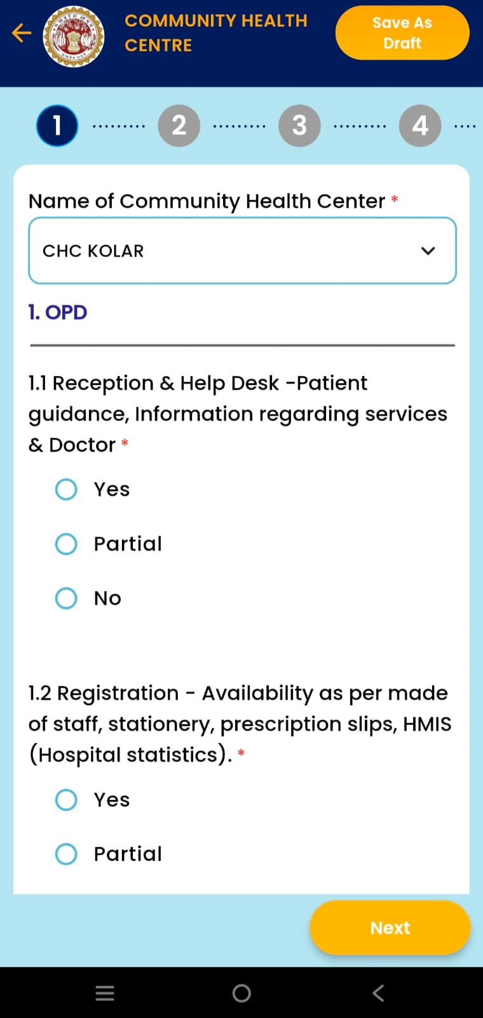
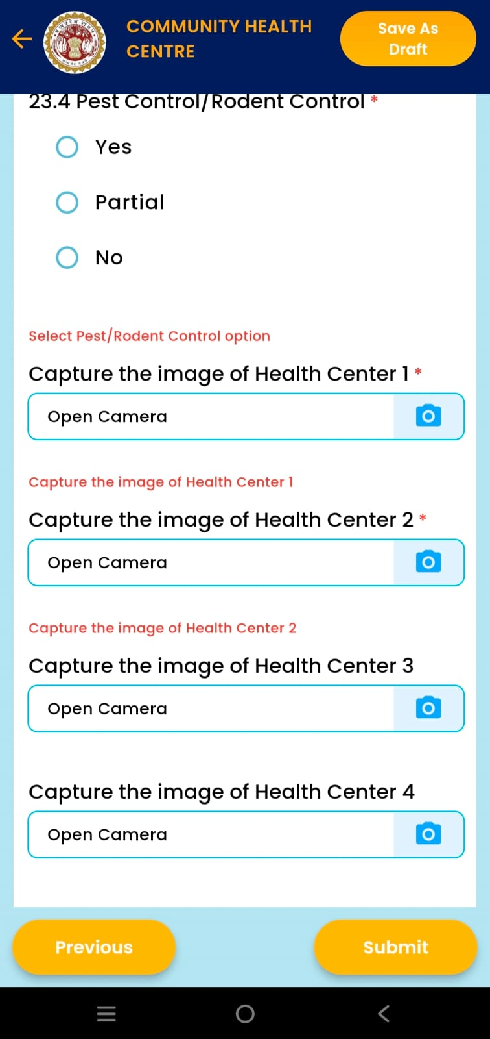
06 | Mobile App — District GIS Parakh
📱 Mobile App Steps
1
2
3
4
5

Slide 13
06 | Mobile — Filling Inspection Forms
01
Select "New Form"
02
Choose Facility Type
Tap "New Forms" card on the MPPHSCL Dashboard.
Select the relevant form e.g. "Community Health Centre" from the available forms list.
03
Fill All Sections
04
Capture Images
Answer every question thoroughly across all sections of the form. Do not skip any mandatory fields.
At the end of the form, photograph the health center properly to document the physical condition.
05
Submit the Form
💡
Offline Support
Once all fields are complete and images are attached, submit the form. It moves to "Submitted Forms".
If no internet is available during inspection, save as Offline Form and submit once connectivity is restored.

Slide 14
Thank You
MPPHSCL Parakh Web Application
User Creation & Hospital Inspection Guide Please User Manual - MPPHSCL Parakh User Manual (User Creation) - Health_Deptartment_Hospital Inspection Web & Mobile Version
📞 Contact & Support
🔗 Application Links
🏢 MPSEDC, State IT Center
47-A, Arera Hills, Bhopal, M.P. – 462011
📞 +91-755-2518300
📠 +91-755-2579824
🌐 www.mpsedc.mp.gov.in
Web Application:
gisuat.mp.gov.in/parakhweb/
Mobile App:
District GIS Parakh
(Available on Play Store)
Government of Madhya Pradesh | Health Department | MPPHSCL Parakh System

